Slide 1

Software Engineering
Documentation for spring-boot application

Slide 2
Our project is an application “To-do List", you can specify the tasks you want to achieve, write a description of them, determine when you will do them, and also determine whether you have completed them or not.
Spring-boot application

Slide 3
What Is This Project Containing
Our Project contains 4 main classes Admin ,User ,Review and to-do list
The user can control to-do list where he can add task and can modify it or delete it if he want , and all this of course is recorded in the database
The user can also Sign up , Sign in and he can also evaluate the application by writing a comment
Admin can control the user where he can create account for user or delete account for user and surely Admin can make account for himself and can modify it or delete it

Slide 4
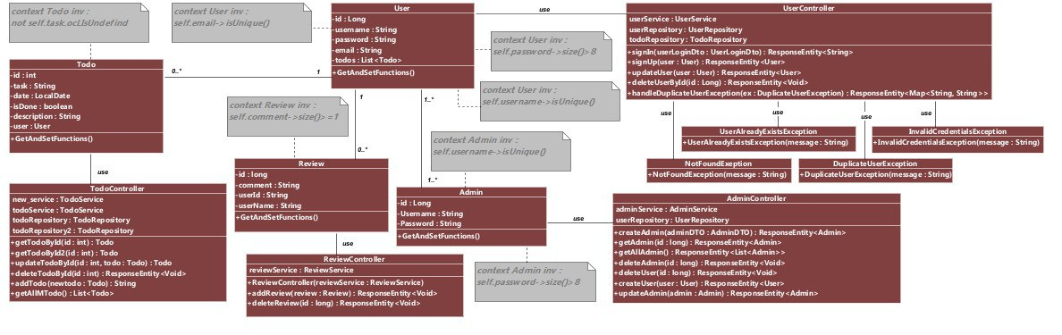
Class Diagram

Slide 5
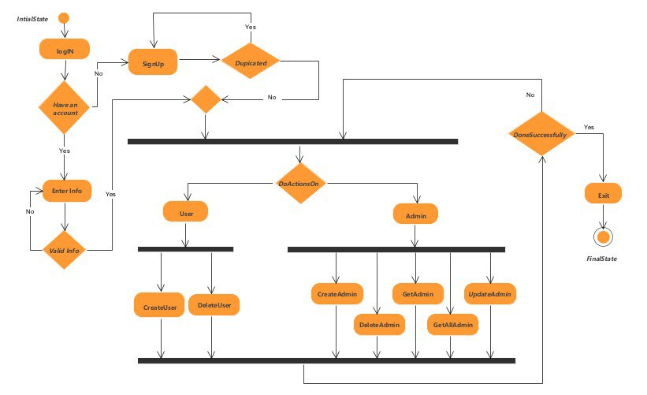
Activity Diagram (admin)

Slide 6
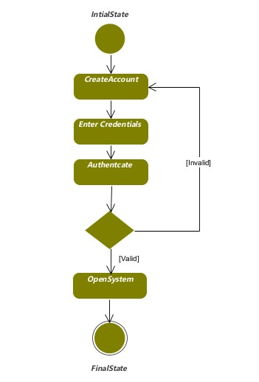
State Diagram (create account)

Slide 7
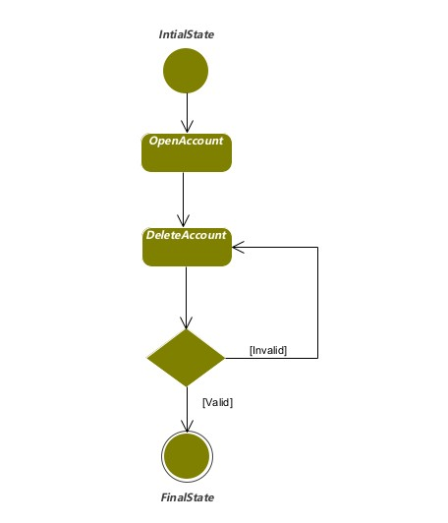
State Diagram (delete account)

Slide 8
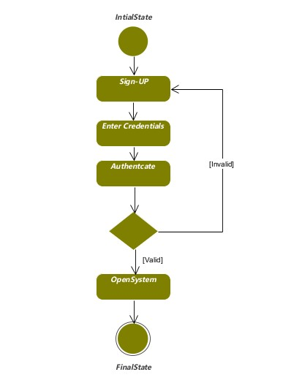
State Diagram(sign up)

Slide 9
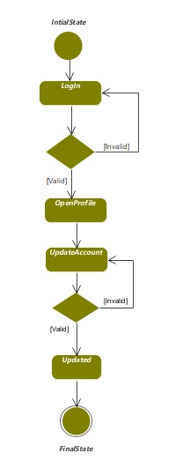
State Diagram(update account)

Slide 10
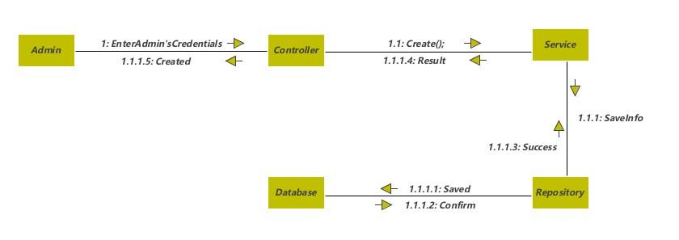
Collaboration Diagram(create Admin)

Slide 11
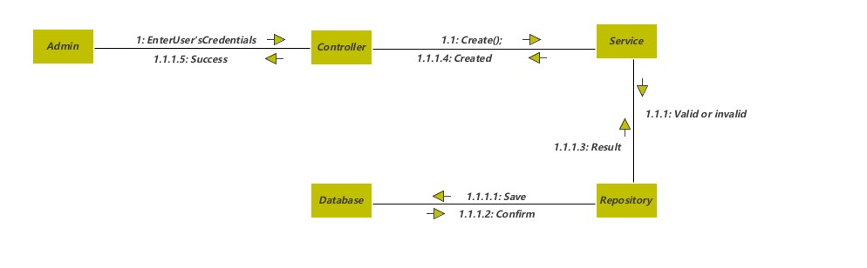
Collaboration Diagram(create User)

Slide 12
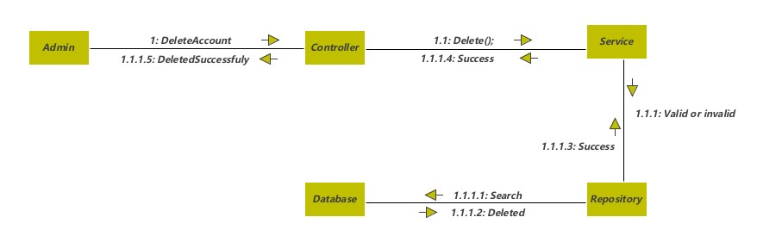
Collaboration Diagram(delete Admin)

Slide 13
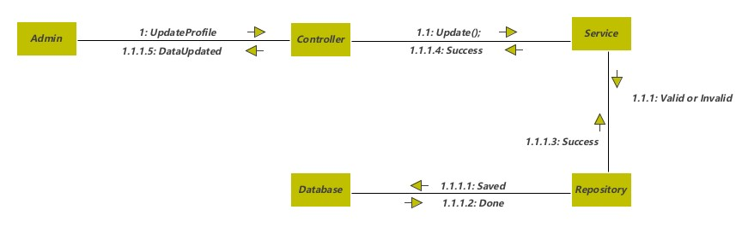
Collaboration Diagram(Update Admin)

Slide 14
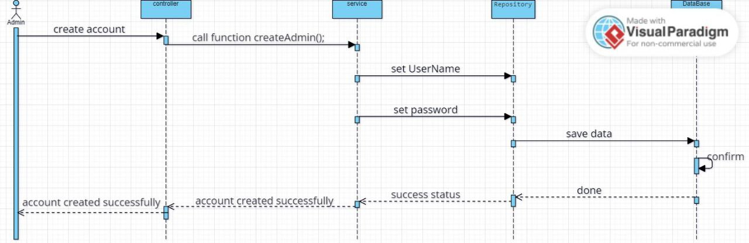
Sequence Diagram(create admin)

Slide 15
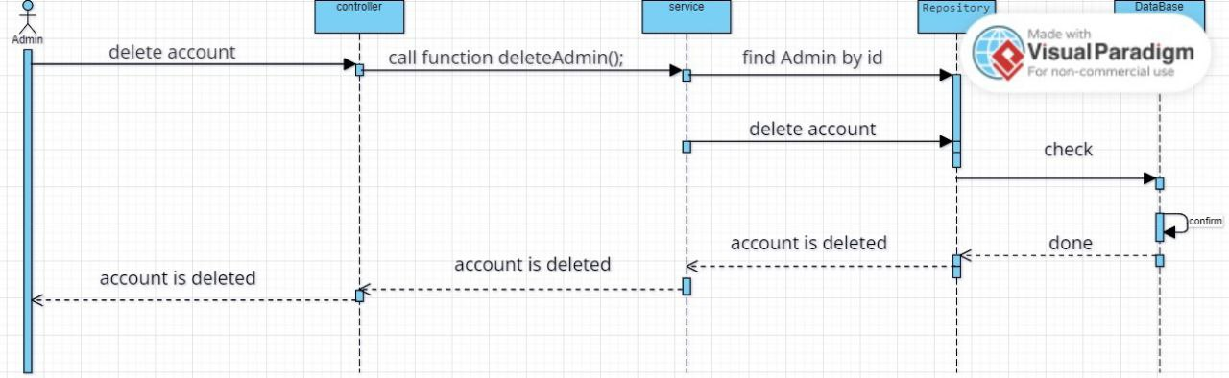
Sequence Diagram(delete admin)

Slide 16
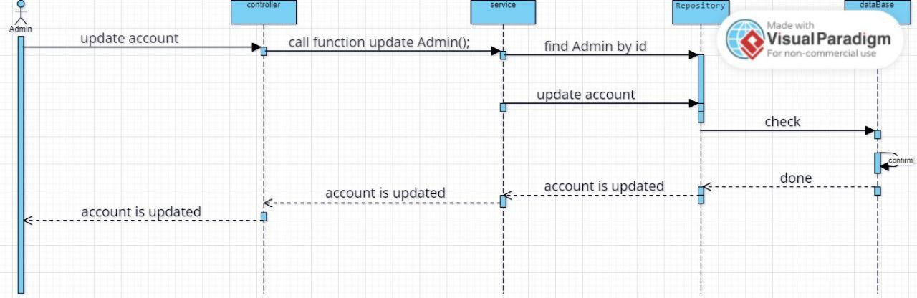
Sequence Diagram(Update Admin)

Slide 17
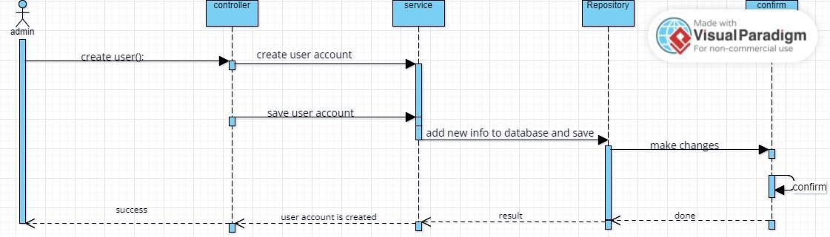
Sequence Diagram(create account for user)

Slide 18
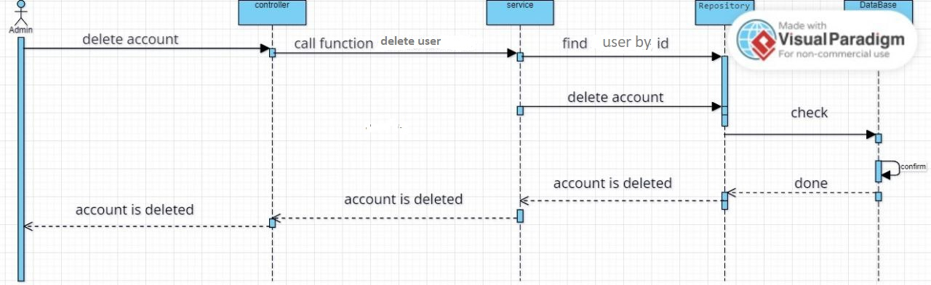
Sequence Diagram(delete account for user)

Slide 19
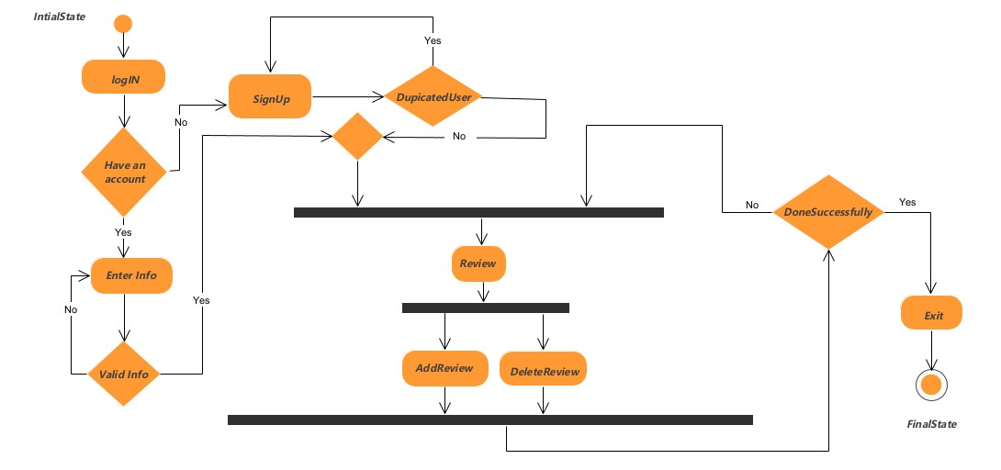
Activity Diagram

Slide 20
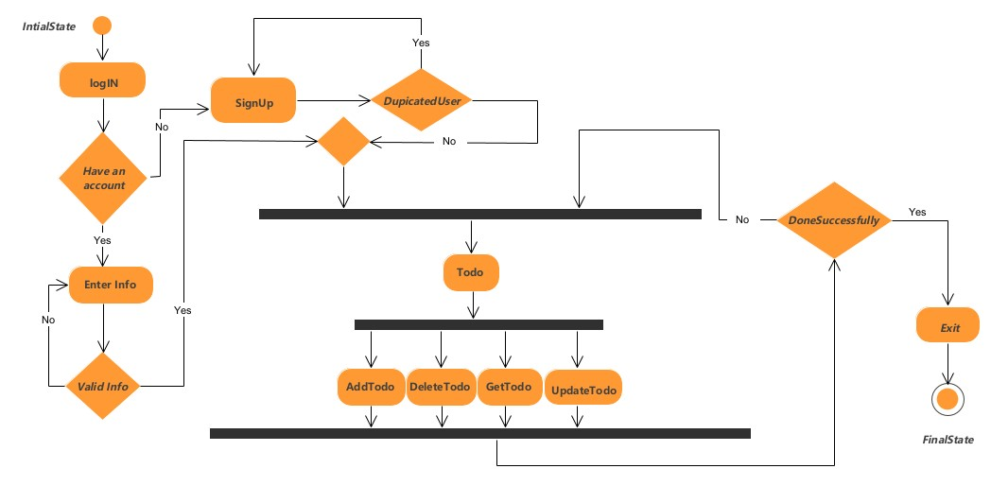
Activity Diagram

Slide 21
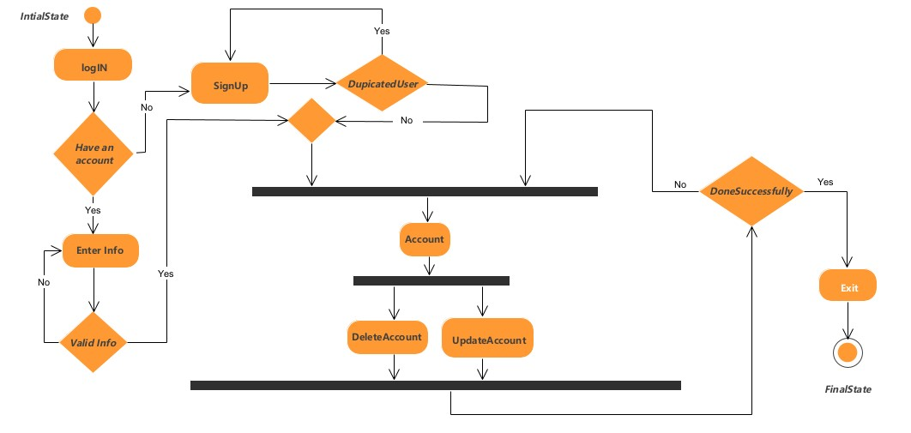
Activity Diagram

Slide 22
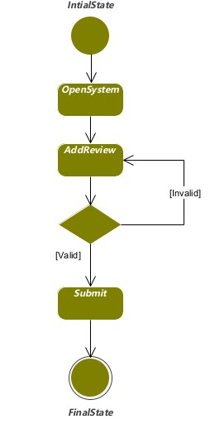
State Diagram (Add Review)

Slide 23
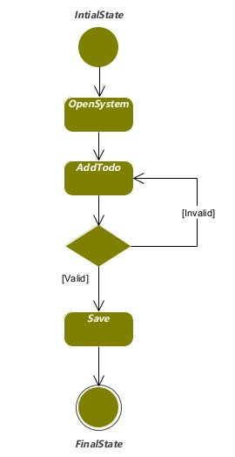
State Diagram (Add List)

Slide 24
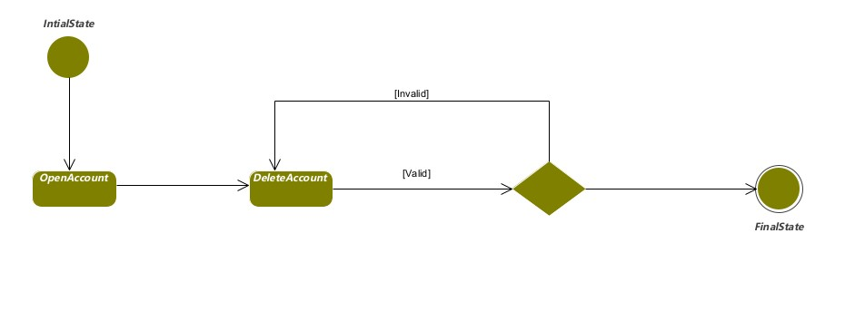
State Diagram (Delete Account)

Slide 25
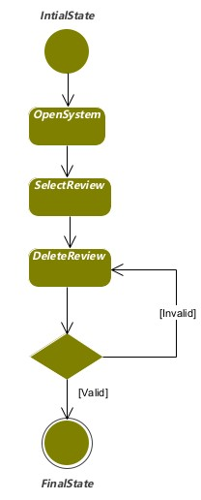
State Diagram (Delete Review)

Slide 26
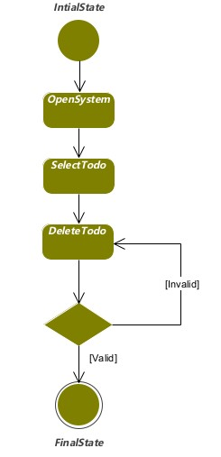
State Diagram (Delete List)

Slide 27
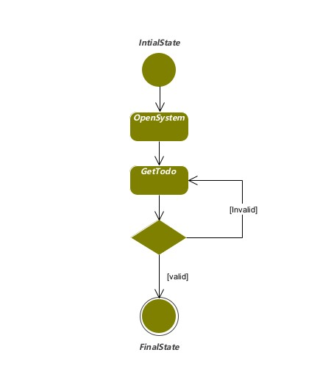
State Diagram (Return List)

Slide 28
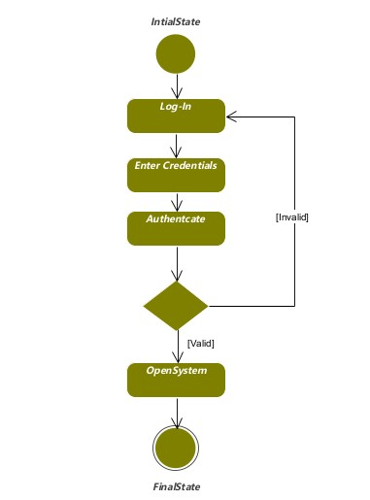
State Diagram (Login)

Slide 29
State Diagram (Sign up)

Slide 30
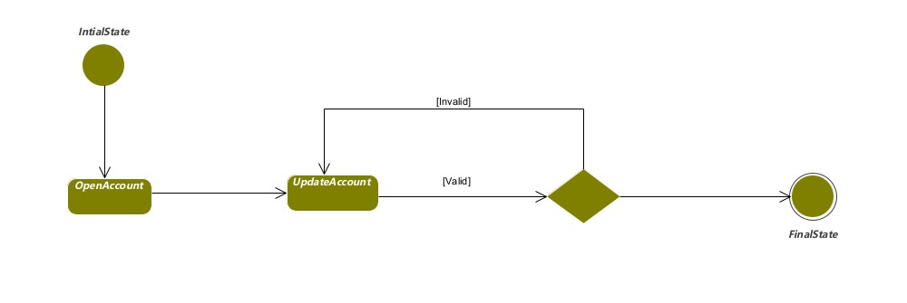
State Diagram (Update account)

Slide 31
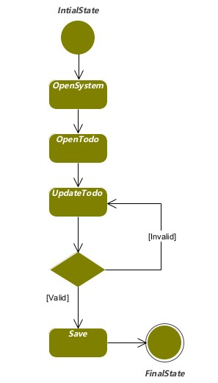
State Diagram (Update List)

Slide 32
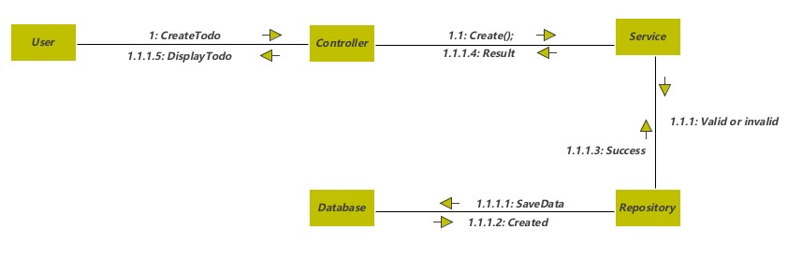
Collaboration Diagram (Create List)

Slide 33
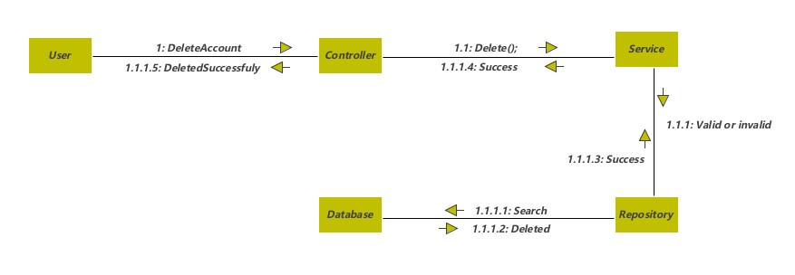
Collaboration Diagram (Delete Account)

Slide 34
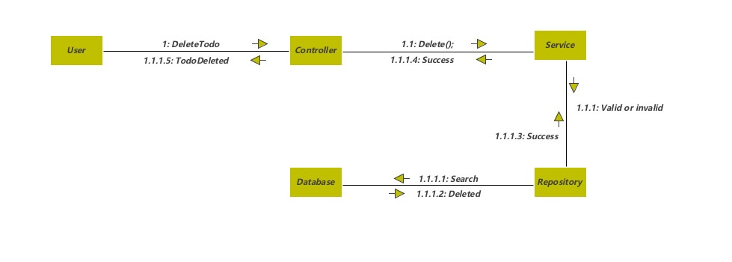
Collaboration Diagram (Delete List)

Slide 35
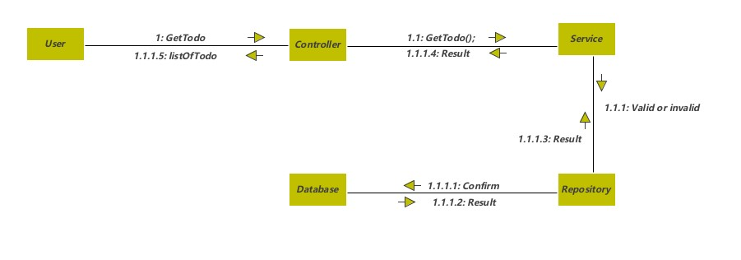
Collaboration Diagram (return List)

Slide 36
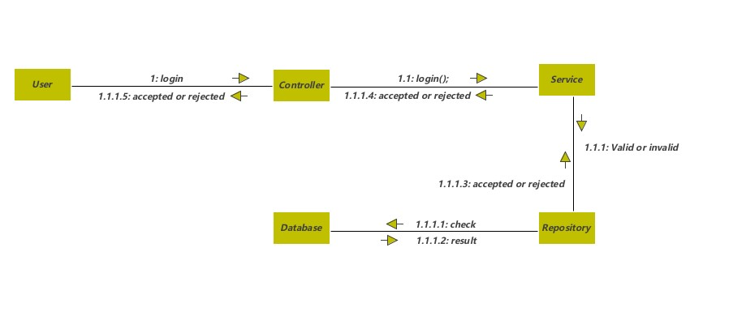
Collaboration Diagram (Login)

Slide 37
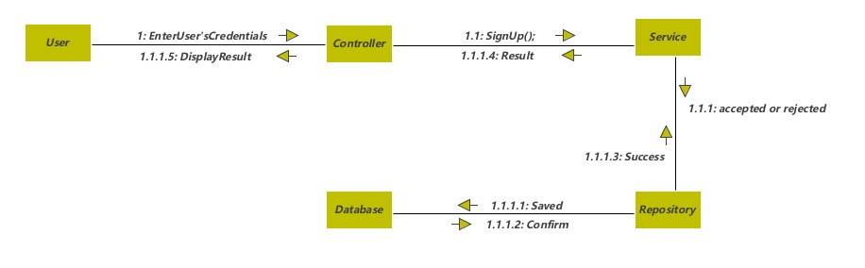
Collaboration Diagram (Sign up)

Slide 38
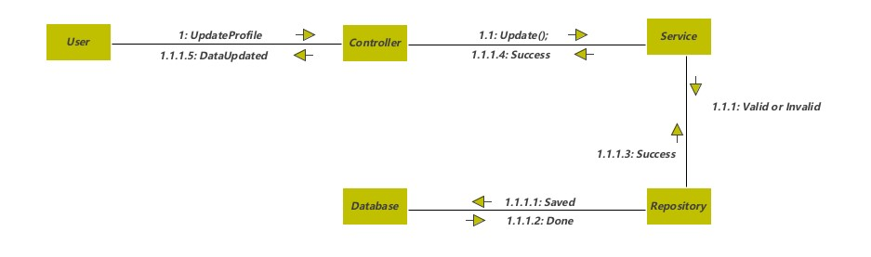
Collaboration Diagram (Update Account)

Slide 39
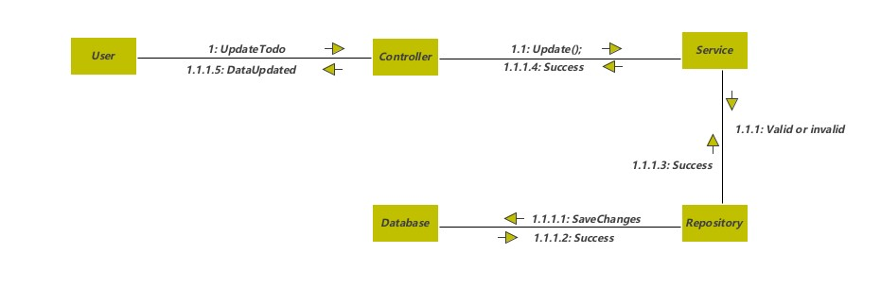
Collaboration Diagram (Update List)

Slide 40
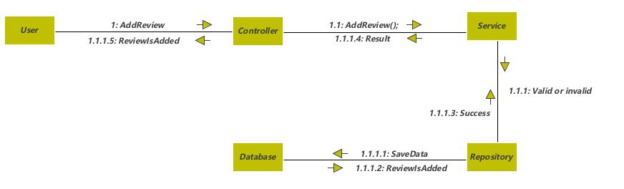
Collaboration Diagram (Add Review)

Slide 41
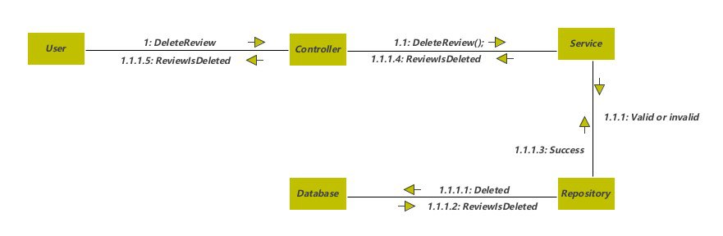
Collaboration Diagram (Delete Review)

Slide 42
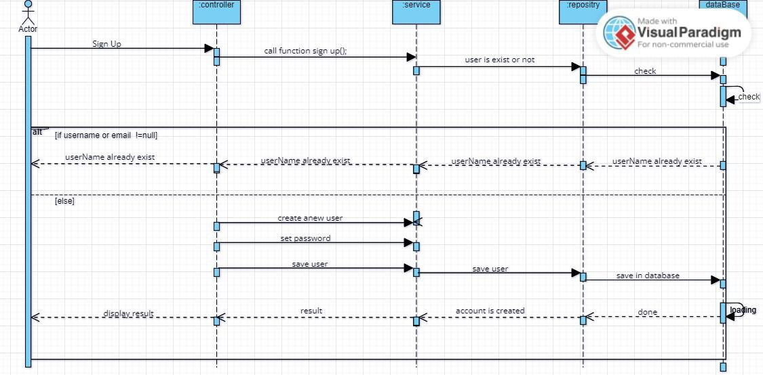
Sequence Diagram (sign up)

Slide 43
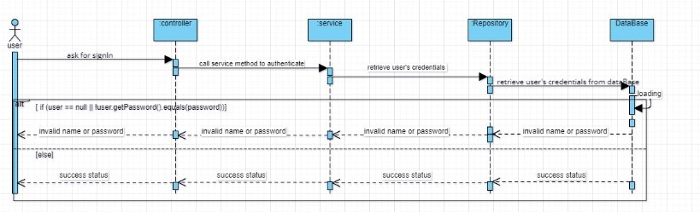
Sequence Diagram (sign in)

Slide 44
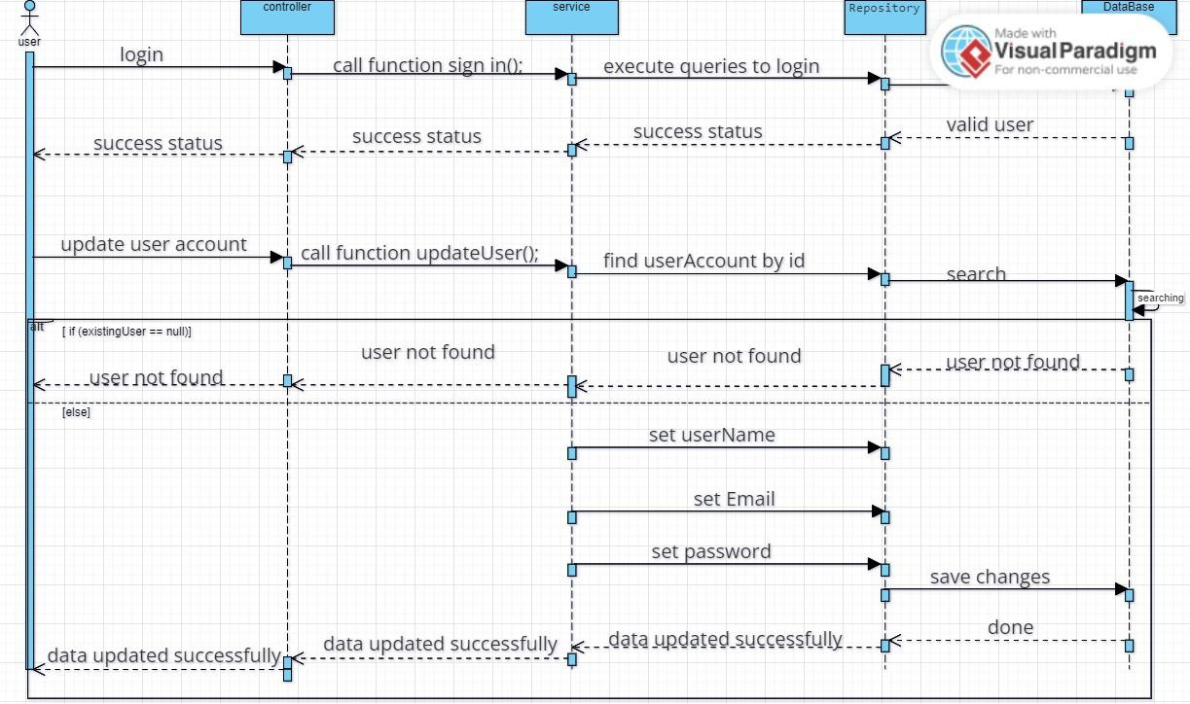
Sequence Diagram (update account)

Slide 45
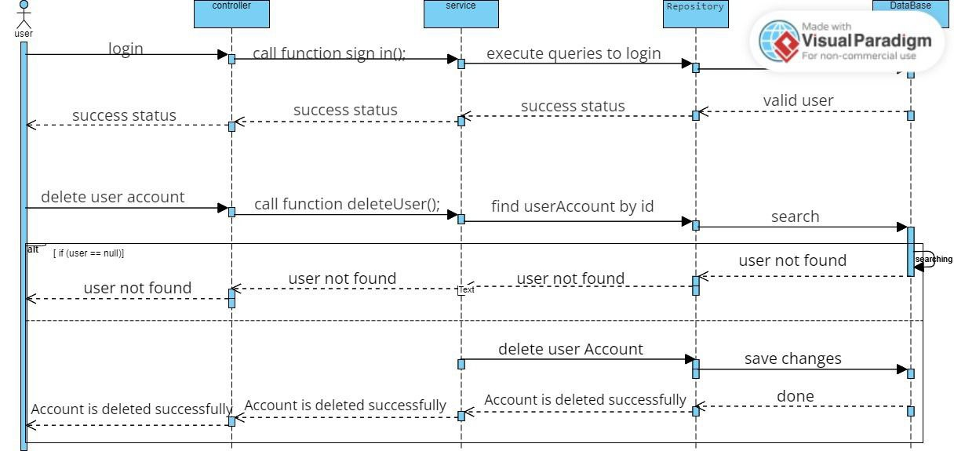
Sequence Diagram (delete user account)

Slide 46
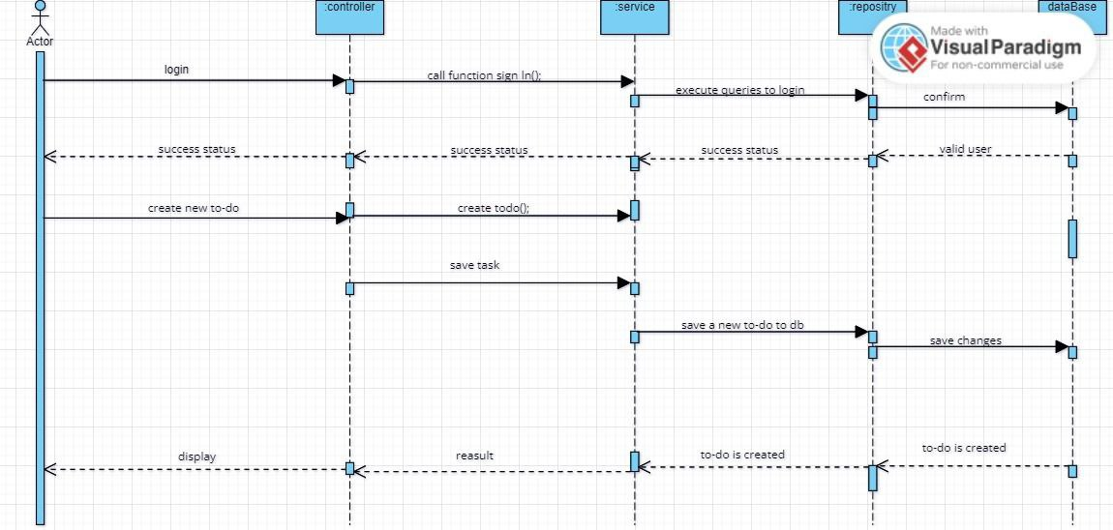
Sequence Diagram (Create list)

Slide 47
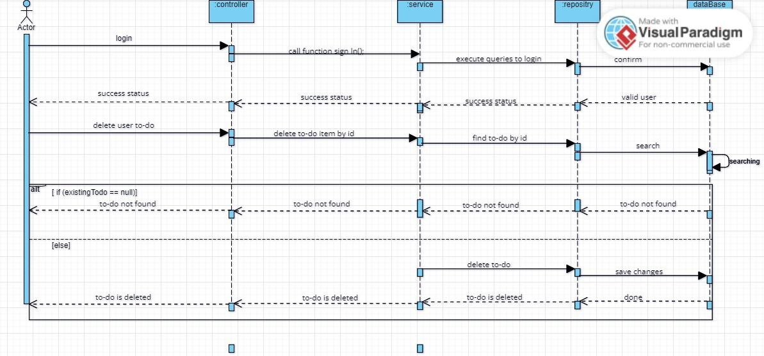
Sequence Diagram (delete list)

Slide 48
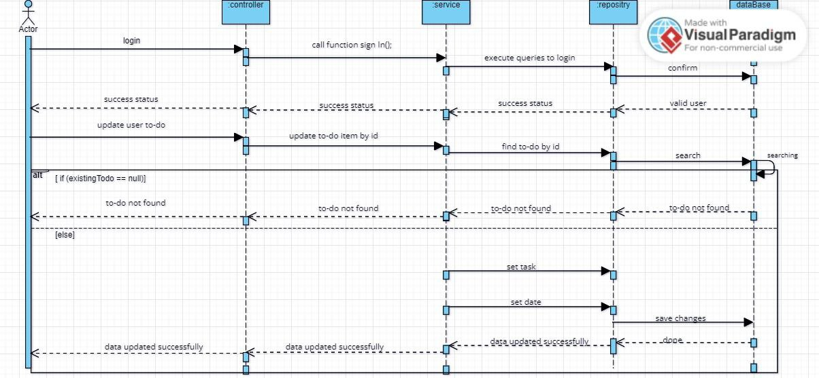
Sequence Diagram (update list)

Slide 49
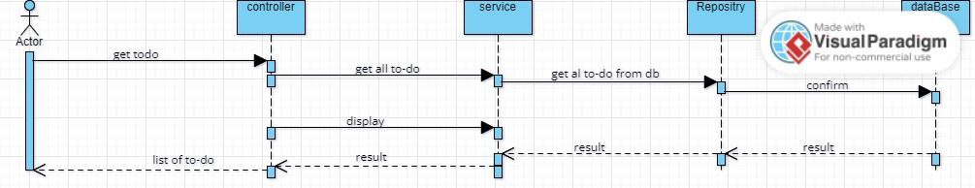
Sequence Diagram (return all lists)

Slide 50
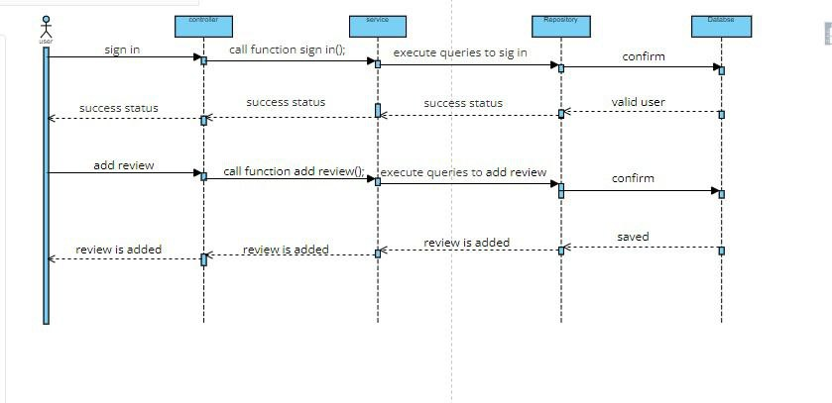
Sequence Diagram (Add Review)

Slide 51
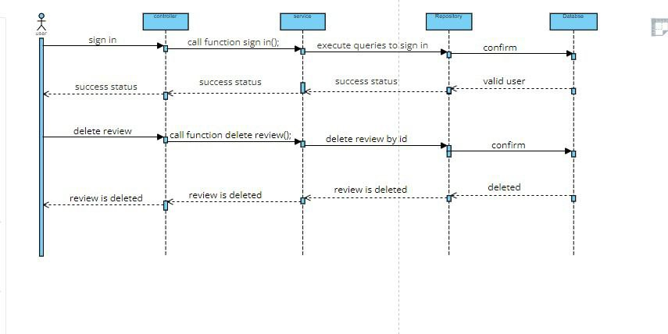
Sequence Diagram (Delete Review)

Slide 52
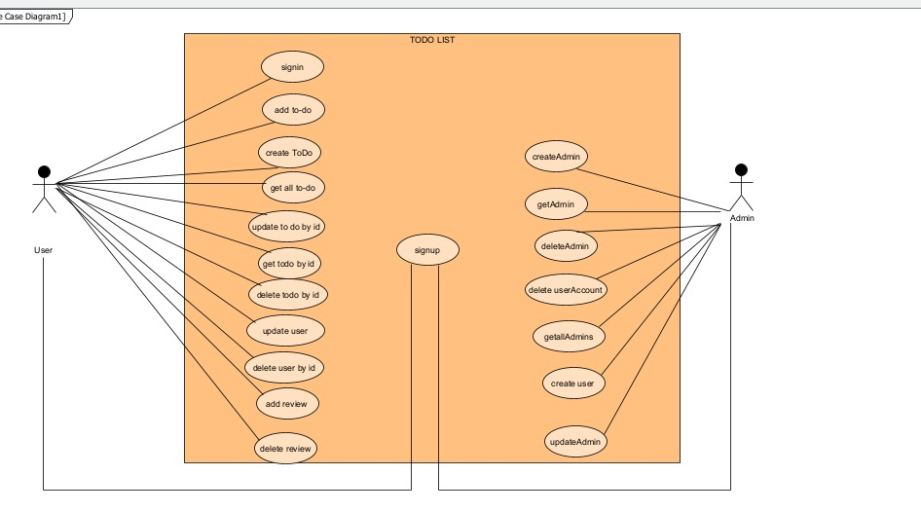
Use Case

Slide 53
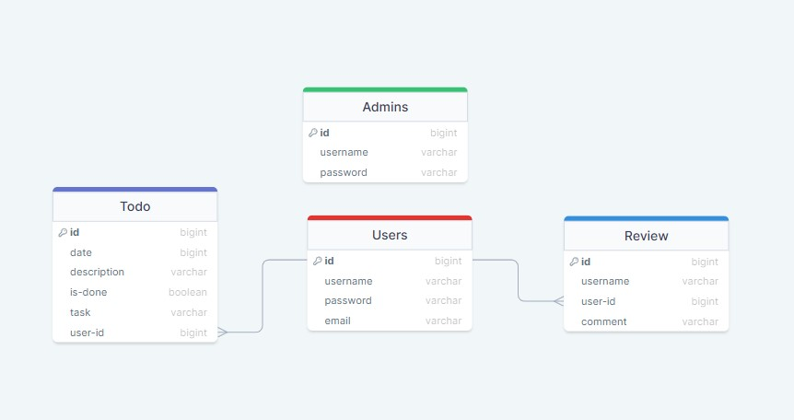
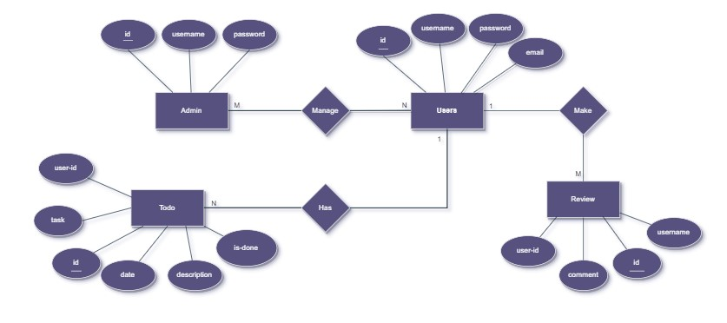
Database Architecture

